Slide 1
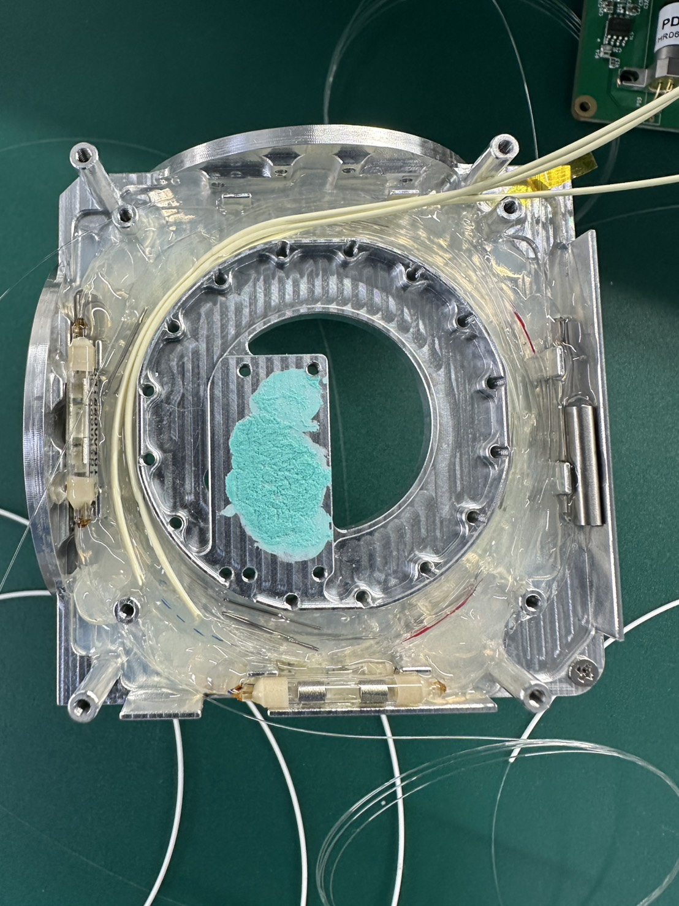
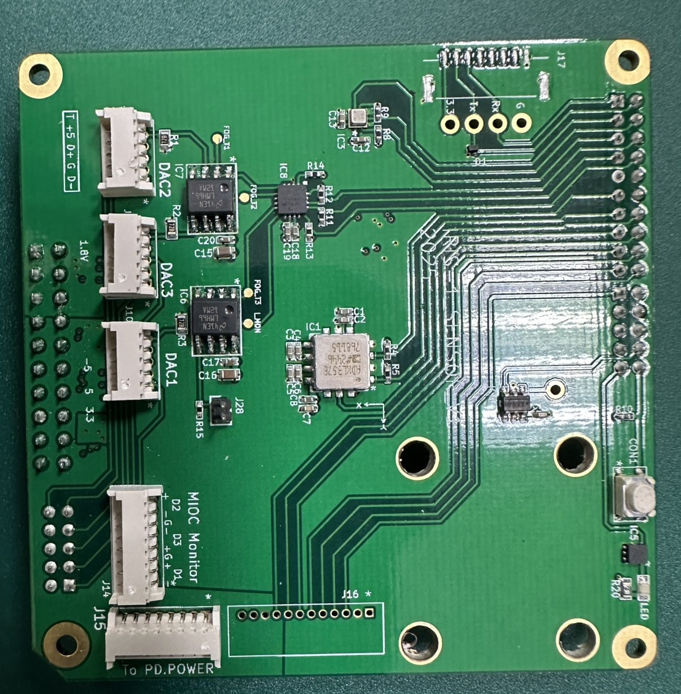
z
PD1 > DAC1 > 實際z軸(GUI目前為x軸)
PD2 > DAC3 > 實際x軸(GUI目前為z軸)
PD3 > DAC2 > 實際y軸(GUI目前為y軸)
y
電路安排
PD1 | ADC_1_1
PD2 | ADC_2_2
PD3 | ADC_2_1
DAC1 | DAC_1_1
DAC3 | DAC_2_2
DAC2 | DAC_2_1
x
Port2, PD2, x-axis
Port3, PD3, y-axis
Port1, PD1, z-axis

Slide 2
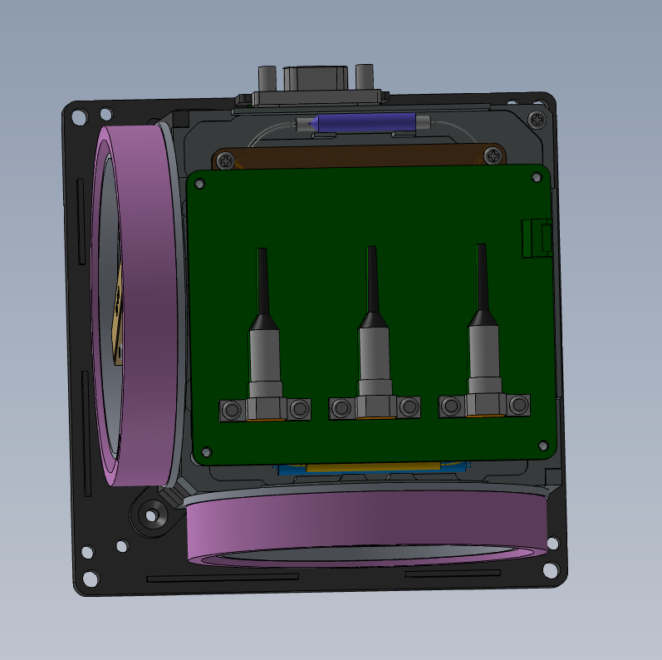
Y
X

Slide 3
硬體軸向已固定，
Y
IRIS Coil or MEMS IMU
IRIS
HARS
X
Y
Conn.
X
X
MINS
Sensor Frame
IRIS: 由coil方向決定
HARS: 由PCB上IMU決定
Y
Conn.
Case Frame

Slide 4
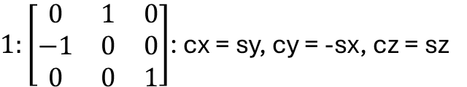
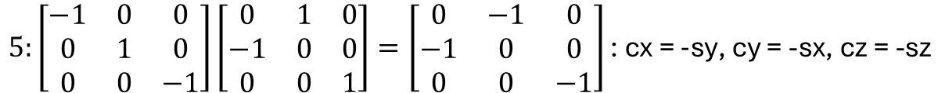
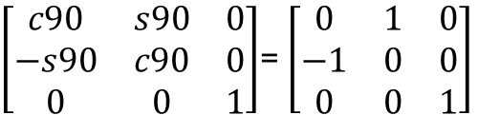
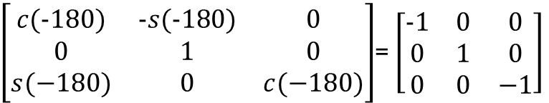
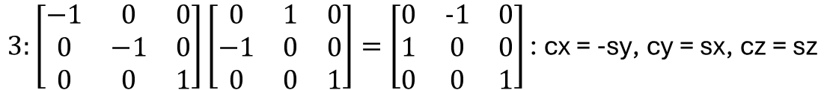
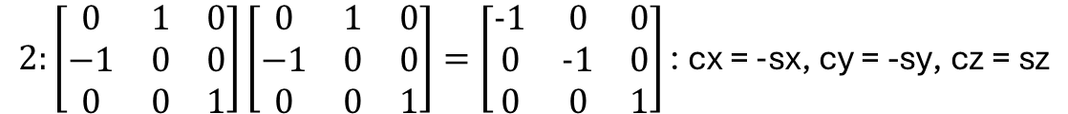
在MCU端提供一個旋轉Sensor frame 方法
rotate_sensorFrame(g_s, a_s, g_c, a_c):
g_s: sensor frame 3 軸 gyro 數據 [g_sx, g_sy, g_sz]
a_s: sensor frame 3 軸 accl 數據 [a_sx, a_sy, a_sz]
g_c: case frame 3 軸 gyro 數據 [g_cx, g_cy, g_cz]
a_c: case frame 3 軸 accl 數據 [a_cx, a_cy, a_cz]
0. Inertial sensor frame 初始
Inertial sensor frame 沿Z軸逆時針旋轉90度*1
Inertial sensor frame沿Z軸逆時針旋轉90度*2
Inertial sensor frame沿Z軸逆時針旋轉90度*3
Inertial sensor frame 沿Y軸逆時針旋轉180度
Inertial sensor frame 沿Y軸逆時針旋轉180度後沿Z軸逆時針旋轉90度*1
Inertial sensor frame 沿Y軸逆時針旋轉180度後沿Z軸逆時針旋轉90度*2
Inertial sensor frame 沿Y軸逆時針旋轉180度後沿Z軸逆時針旋轉90度*3
$\left[\begin{matrix}c90 & s90 & 0 \\ −s90 & c90 & 0 \\ 0 & 0 & 1\end{matrix}\right]$= $\left[\begin{matrix}0 & 1 & 0 \\ −1 & 0 & 0 \\ 0 & 0 & 1\end{matrix}\right]$
沿Z軸逆時針旋轉90
$1:\left[\begin{matrix}0 & 1 & 0 \\ −1 & 0 & 0 \\ 0 & 0 & 1\end{matrix}\right]$: cx = sy, cy = -sx, cz = sz
$$2:\left[\begin{matrix}0 & 1 & 0 \\ −1 & 0 & 0 \\ 0 & 0 & 1\end{matrix}\right]\left[\begin{matrix}0 & 1 & 0 \\ −1 & 0 & 0 \\ 0 & 0 & 1\end{matrix}\right]=\left[\begin{matrix}−1 & 0 & 0 \\ 0 & −1 & 0 \\ 0 & 0 & 1\end{matrix}\right]\text{: }\text{cx}\text{ = }−\text{s}\text{x}\text{, }\text{cy}\text{ = −}\text{sy}\text{, }\text{cz}\text{ = }\text{sz}$$
$$3:\left[\begin{matrix}−1 & 0 & 0 \\ 0 & −1 & 0 \\ 0 & 0 & 1\end{matrix}\right]\left[\begin{matrix}0 & 1 & 0 \\ −1 & 0 & 0 \\ 0 & 0 & 1\end{matrix}\right]=\left[\begin{matrix}0 & −1 & 0 \\ 1 & 0 & 0 \\ 0 & 0 & 1\end{matrix}\right]\text{: }\text{cx}\text{ = }−\text{s}\text{y}\text{, }\text{cy}\text{ = }\text{sx}\text{, }\text{cz}\text{ = }\text{sz}$$
4. 沿Y軸逆時針旋轉180
$\left[\begin{matrix}c(−180) & −s(−180) & 0 \\ 0 & 1 & 0 \\ s(−180) & 0 & c(−180)\end{matrix}\right]$= $\left[\begin{matrix}−1 & 0 & 0 \\ 0 & 1 & 0 \\ 0 & 0 & −1\end{matrix}\right]$
$$5:\left[\begin{matrix}−1 & 0 & 0 \\ 0 & 1 & 0 \\ 0 & 0 & −1\end{matrix}\right]\left[\begin{matrix}0 & 1 & 0 \\ −1 & 0 & 0 \\ 0 & 0 & 1\end{matrix}\right]=\left[\begin{matrix}0 & −1 & 0 \\ −1 & 0 & 0 \\ 0 & 0 & −1\end{matrix}\right]\text{: }\text{cx}\text{ = }−\text{s}\text{y}\text{, }\text{cy}\text{ = −}\text{sx}\text{, }\text{cz}\text{ = −}\text{sz}$$

Slide 5
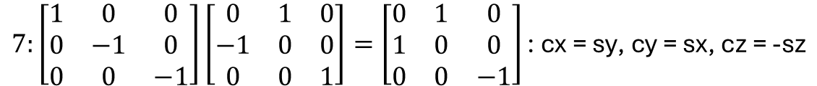
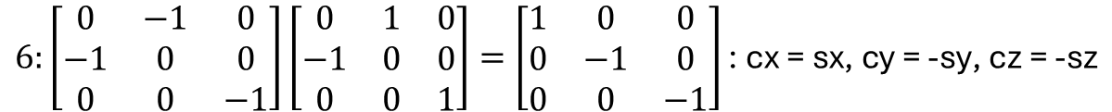
$$6:\left[\begin{matrix}0 & −1 & 0 \\ −1 & 0 & 0 \\ 0 & 0 & −1\end{matrix}\right]\left[\begin{matrix}0 & 1 & 0 \\ −1 & 0 & 0 \\ 0 & 0 & 1\end{matrix}\right]=\left[\begin{matrix}1 & 0 & 0 \\ 0 & −1 & 0 \\ 0 & 0 & −1\end{matrix}\right]\text{: }\text{cx}\text{ = }\text{sx}\text{, }\text{cy}\text{ = −}\text{sy}\text{, }\text{cz}\text{ = −}\text{sz}$$
$$7:\left[\begin{matrix}1 & 0 & 0 \\ 0 & −1 & 0 \\ 0 & 0 & −1\end{matrix}\right]\left[\begin{matrix}0 & 1 & 0 \\ −1 & 0 & 0 \\ 0 & 0 & 1\end{matrix}\right]=\left[\begin{matrix}0 & 1 & 0 \\ 1 & 0 & 0 \\ 0 & 0 & −1\end{matrix}\right]\text{: }\text{cx}\text{ = }\text{sy}\text{, }\text{cy}\text{ = }\text{sx}\text{, }\text{cz}\text{ = −}\text{sz}$$
旋轉完後，再讓g_c 與 a_c取代原本的input做後續運算

Slide 6
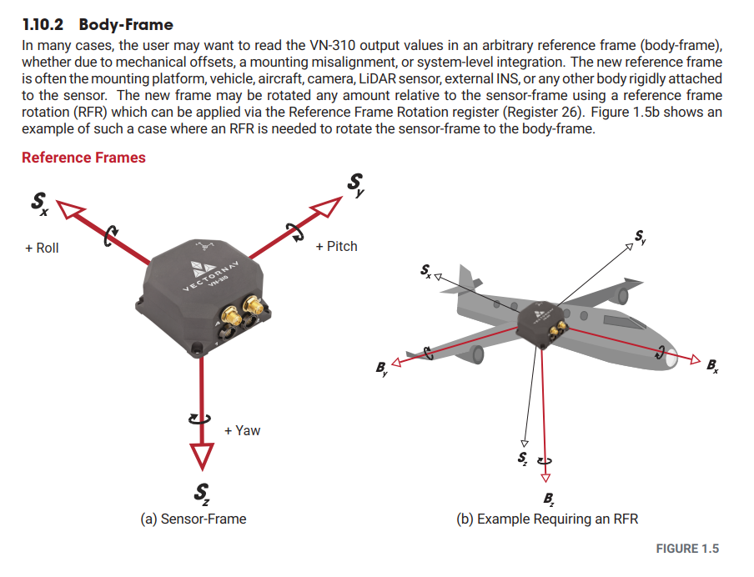
可藉由RFR來旋轉Sensor frame來match body frame

Slide 7
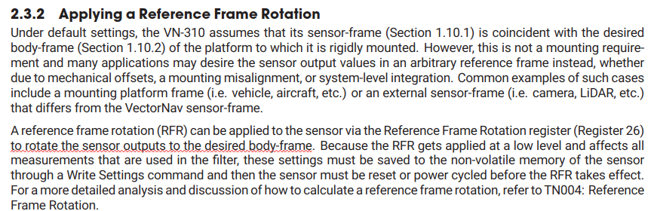

Slide 8
姿態角VectorNav文件:
https://www.vectornav.com/resources/inertial-navigation-primer/math-fundamentals/math-attituderep

Slide 9
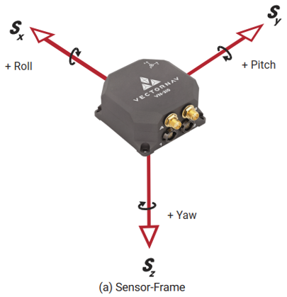
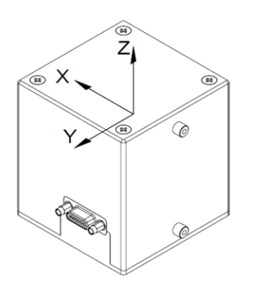
Z
Y
X

Slide 10
IRIS Coil or MEMS IMU
Y
IRIS
HARS
get_raw_data()
X
Y
Conn.
frame_rotate()
X
Sensor Frame
IRIS: 由coil方向決定
HARS: 由PCB上IMU決定
Case Frame

Slide 11
09/15/2025 更新MCU程式

